Slide 1
MODULE THREE
Stages of Treatment and Core Processes

Slide 2
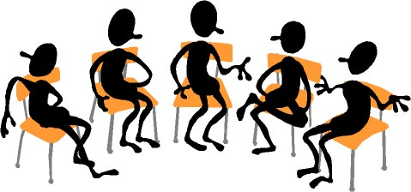
Learning Activities
Group Discussions
Giving and Receiving Feedback
Questions and Answers
,

Slide 3
Materials and Exercises
Exercises
Identify Consumers with Co-Occurring Disorders
Review Assessment and Treatment Planning Forms
Handouts
Screening for co-occurring disorders
Conducting integrated assessments
Developing integrated treatment plans
Agency Policy and Procedures , admission, discharge criteria, assessment, diagnosis of co-occurring disorders, integrated treatment policies and procedures.

Slide 4
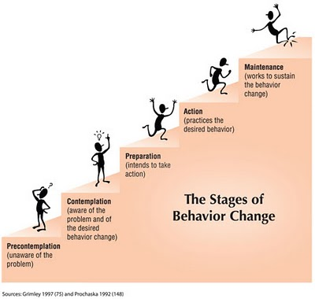
The Stages of Change
Recovery from a substance abuse disorder is a Step-By-Step Process that occurs over time and can be described in stages.

Slide 5
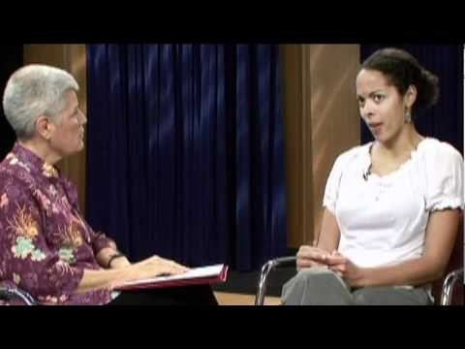
Stages of Change and Treatment Video

Slide 6

The Stages of Change
Stage One
Precontemplation
People who don’t recognize their substance abuse as a problem.
DENIAL

Slide 7

The Stages of Change
Stage Two
Contemplation
People who become aware that their substance abuse is a potential problem.
POSSIBILTY

Slide 8
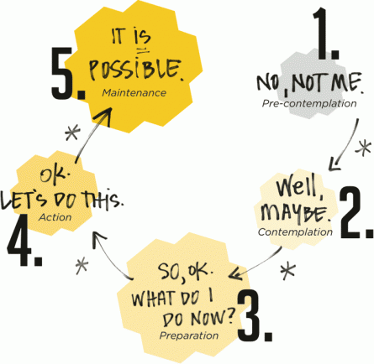
The Stages of Change
Stage Three
Preparation
People who decide to change and are committed to change.
A PLAN

Slide 9
The Stages of Change
Stage Four
Action
People who decide to change by using their plan.
ACTION

Slide 10
The Stages of Change
Stage Five
Maintenance
People use strategies to maintain abstinence.
MAINTENANCE

Slide 11


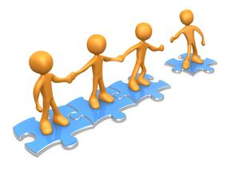
The Stages of Treatment
Engagement
Active Treatment
Are the internal processes that people go through and are offered interventions at different stages.
Persuasion
Relapse Prevention

Slide 12

The Stages of Treatment
Stage One
Engagement
People who don’t recognize their substance abuse as a problem need help to become engaged in integrated treatment
Help Facing Challenges

Slide 13

The Stages of Treatment
Stage Two
Persuasion
People who become aware that their substance abuse is a potential problem and are committing to change.
Motivational Counseling

Slide 14

The Stages of Treatment
Stage Three
Active Treatment
People who recognize substance abuse is a problem and decide to reduce or stop using altogether
Learning new skills and finding support to avoid substances

Slide 15
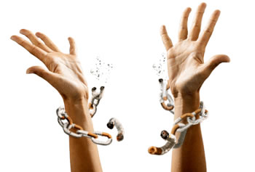
The Stages of Treatment
Stage Four
Maintenance
People who use strategies to maintain abstinence
Relapse Prevention

Slide 16
Challenge Question 1

Slide 17

Recovery from a substance abuse disorder occurs over time. This process can be described as
Which answer would you choose?
Stages
Steps
Phases
Next

Slide 18
1A Correct Choice
Good Job
If you chose this answer you are correct!

Slide 19
1B Incorrect Choices
These are known as stages
If you chose this answer you are not correct.

Slide 20
1C incorrect Choices
These are called stages.
If you chose this answer you are not correct.

Slide 21
Challenge Question 2

Slide 22
Which stage describes a consumers who decides to change and is committed to change
Which answer would you choose?
Denial
Contemplation
Preparation

Slide 23
1A Correct Choice
Good Job
If you chose this answer you are correct!

Slide 24
1B Incorrect Choices
Denial does not recognize the problem
If you chose this answer you are not correct.

Slide 25
1C incorrect Choices
Contemplation is considering a change.
If you chose this answer you are not correct.

Slide 26
Challenge Question 3

Slide 27
Motivational Counseling Can Be Useful for Consumers in which Stage of Treatment?
Which answer would you choose?
Engagement
Persuasion
Active Treatment

Slide 28
1A Correct Choice
Good Job
If you chose this answer you are correct!

Slide 29
1B Incorrect Choices
Denial does not recognize the problem
If you chose this answer you are not correct.

Slide 30
1C incorrect Choices
Contemplation is considering a change.
If you chose this answer you are not correct.

Slide 31

Summary
Summary
The first Module reviewed the basic elements of Integrated Treatment for Co-Occurring Disorders.
The second Module provided information about the commonly used terms when defining substance use.
The third module will discuss the stages of treatment and, the different stages of change and the types of treatment.
The fourth module will discuss practical skills for integrated treatment.

Slide 32
Congratulations
Module Three Completed

