Slide 1
Intensive Outpatient Staff Training Program
The Integrated Treatment Program for Adults with Co-occurring Substance Abuse and Mental Health Disorders

Slide 2
WELCOME EVERYONE
Overview
This course is designed for staff who will be working with clients who suffer from Co-Occurring Disorders.
This program will be using the Integrated Dual Diagnosis Treatment Model (IDDT)
The course will be divided into 5 modules over a 5 week period.
You will cover one module each week.
We will use different instructional materials such as handouts, videos etc.

Slide 3

Module Topics
Modules
Basic Elements and Practice Principles
Practical Knowledge of Common Substances
Stages of treatment and Core Processes
Practical skills for Integrated Treatment
Service Formats

Slide 4
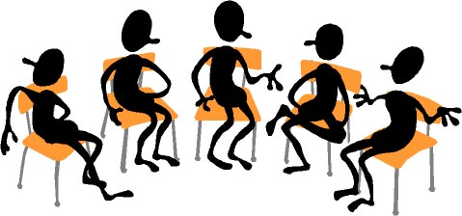
Learning Activities
Group Discussions
Giving and Receiving Feedback
Questions and Answers
,

Slide 5
Materials and Exercises
Exercises
Explore the benefits of Integrated Treatment of Co-occurring Disorders
Improve your Integrated Treatment Program
Handouts
Integrated Treatment Fidelity Scale
General Organization Index (GOI)
Outcome Measures used by the Step-By-Step Program

Slide 6
Practice Principles of Integrated Treatment for Co-occurring Disorders
Mental Health and Substance abuse treatment are integrated to meet the needs of people with co-occurring disorders.
Integrated treatment specialists are trained to treat both substance use disorders and serious mental illness
Co-occurring disorders are treated in a stage wise fashion with different services provided at different stages.
Motivational interventions are used to treat consumers in all stages, but especially in the persuasion stage.
Substance abuse counseling, using a cognitive behavioral approach, is used to treat consumers in the active treatment and relapse prevention phase.
Multiple forms for services are available, including individual, group, self-help, and family.
Medication services are integrated and coordinated with psychosocial services.

Slide 7
Practice Principles of Integrated Treatment for Co-occurring Disorders- Principle 1
Mental Health and Substance abuse treatment are integrated to meet the needs of people with co-occurring disorders.
  Up to 50% of people with the most serious mental problems have co-occurring disorders
  Most receive treatment for one or the other from different agencies---if they receive treatment at all.

Slide 8
Practice Principles of Integrated Treatment for Co-occurring Disorders-Principle 2
Integrated treatment specialists are trained to treat both substance use disorders and serious mental illness. They must:
  Be trained in psychopathology, assessment, and treatment strategies for both mental heath and substance abuse.
  Understand the terminology and language used for substance abuse disorders
  They need to learn more about substances that are abused by consumers
    How these substances affect people
    Short and long tem effects of abuse and dependence

Slide 9
Practice Principles of Integrated Treatment for Co-occurring Disorders-Principle 3
Co-occurring disorders are treated in a stage-wise fashion with different services provided at different phases.
The four stages of treatment are:
  Engagement
  Persuasion
  Active treatment
  Relapse treatment

Slide 10
Practice Principles of Integrated Treatment for Co-occurring Disorders-Principle 4
Motivational interventions are used to treat consumers in all stages, especially in the persuasion Motivational interventions include motivational:
  Interviewing
  counseling
  Treatment
  Specific listening and counseling skills are used to help consumers who are demoralized or who are not ready to pursue abstinence.

Slide 11
Practice Principles of Integrated Treatment for Co-occurring Disorders-Principle 5
Motivational interventions are used to treat consumers in all stages, especially in the persuasion Motivational interventions include motivational:
  Interviewing
  counseling
  Treatment
  Specific listening and counseling skills are used to help consumers who are demoralized or who are not ready to pursue abstinence.

Slide 12
Practice Principles of Integrated Treatment for Co-occurring Disorders-Principle 6
Multiple formats are available for services, including individual, group, self-help, and family.
  Consumers in the persuasion phase may benefit from motivational interventions and are recommended. Family support is beneficial when receiving information.
  Group treatment can help consumers not feel alone.
  Groups provide social support and network
  This is helpful for relapse prevention.

Slide 13
Practice Principles of Integrated Treatment for Co-occurring Disorders-Principle 7
Medication services are integrated and coordinated with psychosocial information.
  Prescribers should be integrated into the multidisciplinary treatment program.
  Prescribers should work closely with other members of the treatment team.
  Psychiatric medications should be prescribed with active substance abuse.
  Potentially addictive medicines should be avoided. Offer medications that reduce addictive behavior.

Slide 14
The next slide is a demonstration video that summarizes the Basic Elements and Practice Principles

Slide 15
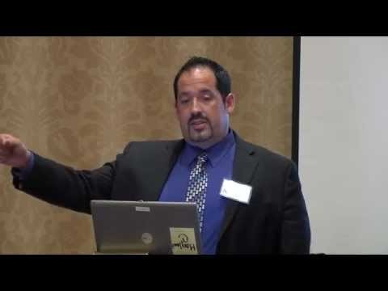
Demonstration Video
Basic Elements and Practice Principles
Click on picture to start video

Slide 16
Summary
Summary
The first Module reviewed the basic elements of Integrated Treatment for Co-Occurring Disorders.
Research has demonstrated its effectiveness
The next module provides integrated treatment specialists with specific knowledge and skills to assess and treat consumers with co-occurring disorders.

Slide 17
Challenge Question One

Slide 18

Practitioners trained in the evidence based models and designated to provide integrated treatment to consumers with co-occurring disorders are called:
Select your answer below
Integrated Treatment Specialists
Mental Health Specialists.
Substance Abuse Specialists.
A
B
C

Slide 19

1A
Congratulations you are correct!
Go To Next Slide

Slide 20

1B
              Wrong Answer
      Mental health Specialists will work with the same team in order to provide coordinated care.
Go To Next Slide

Slide 21

1C
              Wrong Answer
      Substance abuse Counselors will work with the same team in order to provide coordinated care.
Go To Next Slide

Slide 22
Challenge Question Two

Slide 23
Integrated treatment for co-occurring disorders is an evidence-based practice that has been found to be effective in the recovery process for consumers with co-occurring disorders. The goal of this practice is to:
Select your answer below
Support consumers in their recovery process.
Is strictly information for the consumer and not be shared with others.
To emphasize treatment differences between consumers with substance use and mental illness disorders.
A
B
C

Slide 24
1A
Congratulations you are correct!
Go To Next Slide

Slide 25

1B
Wrong Answer This is not the answer
Go To Next Slide

Slide 26

1C
Wrong Answer This is not correct
Go To Next Slide

Slide 27
Challenge Question Three

Slide 28
Consumers recovering from substance use and mental illness disorders go through 4 stages of treatment. And they are:
Select your answer below
Engagement, persuasion, active treatment, relapse prevention
Engagement, persistence, active treatment, relapse prevention
Engagement, persuasion, in-active treatment and prevention
A
1B
C

Slide 29
1A
Congratulations you are correct!
Go To Next Slide

Slide 30

1B
Wrong Answer This is not one of the stages.
Go To Next Slide

Slide 31
1C
Wrong Answer In-active treatment is not one of the stages.
Go To Next Slide

Slide 32
Challenge Question Four

Slide 33
Motivational intervention are used to treat consumers in all stages but especially in what stage?
Select your answer below
Engagement stage
Relapse prevention stage
Persuasion stage
AA
B
C

Slide 34
1A
Congratulations you are correct!
NEXT

Slide 35
1B
Wrong Answer This is not correct
Go To Next Slide

Slide 36
1C
Wrong AnsweThis is the wrong answer.
Go To Next Slide

Slide 37
YOUR SCORE for MODULE ONE
CHALLENGE QUESTIONS
NUMBER OF CORRECT RESPONSES for FOUR QUESTIONS | SCORE | COMMENTS
4 | 100% | Excellent!!
3 | 75% | Good (Passing)
2 | 50% | Poor (Failing)
1 | 25% | Please review the content before continuing to the next module.
Next

Slide 38

Congratulations
You have completed Module One

